Slide 1


Industry Specification Upgrades
ILSAC GF-7 and API SQ
New North American PCO specifications
ILSAC GF-7
API SQ
First License Date: March 31, 2025
Improved engine oil performance

Slide 2
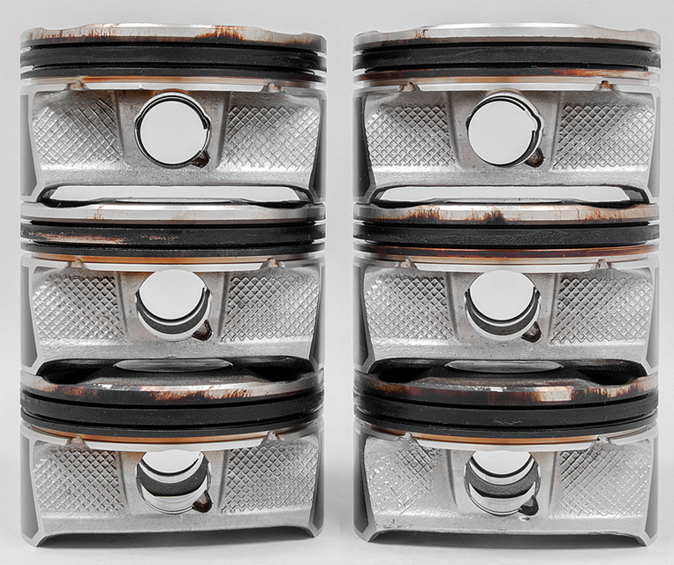

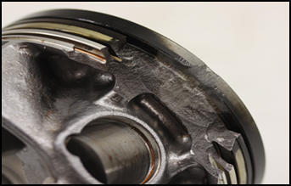
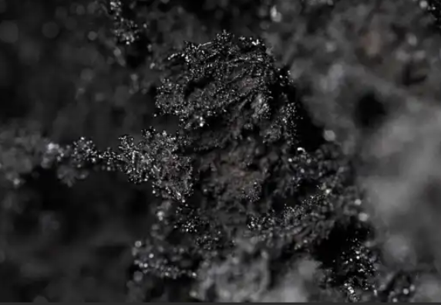
Improved performance – what’s changing?
Key upgrades on new specifications
Better prevention of deposits (Seq. IIIH engine test)
Improved fuel economy (ILSAC GF-7 only, Seq. VIE/F engine test)
Better protection against Low-Speed Pre-Ignition (Seq. IX engine test)
Improved emission system protection – reduced sulfated ash (ASTM D874 bench test)

Slide 3
How does it affect Castrol products?
Many Castrol formulations already met the new requirements for ILSAC GF-7 and API SQ with our current formulations.
These products include:
    EDGE
    EDGE Extended Performance
    EDGE High Mileage
    GTX Full Synthetic
    GTX Full Synthetic High Mileage (new product launch)
ILSAC GF-7 and API SQ cannot be on packaging until first license date.
This is the only reason GF-7 and SQ are not current on these product labels.
GTX and GTX High Mileage will transition to new formulas soon after first license date.

Slide 4
When will I see GF-7 and SQ on Castrol product packaging?
This will be a soft label transition
No changes to part numbers or UPC’s
Packaging will update as existing inventory is depleted
It is possible similar products will claim ILSAC GF-6/API SP and also claim ILSAC GF-7/API SQ during this transition period

Slide 5
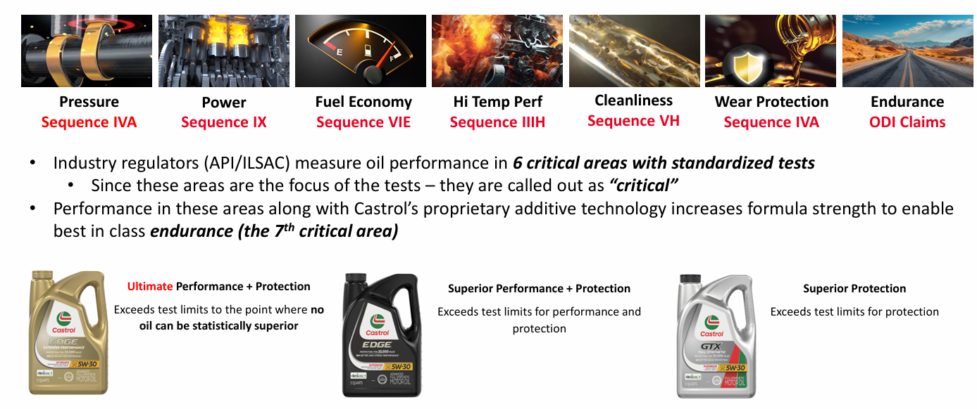
New claims – 7 Critical Areas
Along with the upgrade to ILSAC GF-7 and API SQ, our products will now call our protection in 7 Critical Areas of the engine

Slide 6
